Slide 1

Food First Inc

Slide 2
Jira Project Workflow

Slide 3
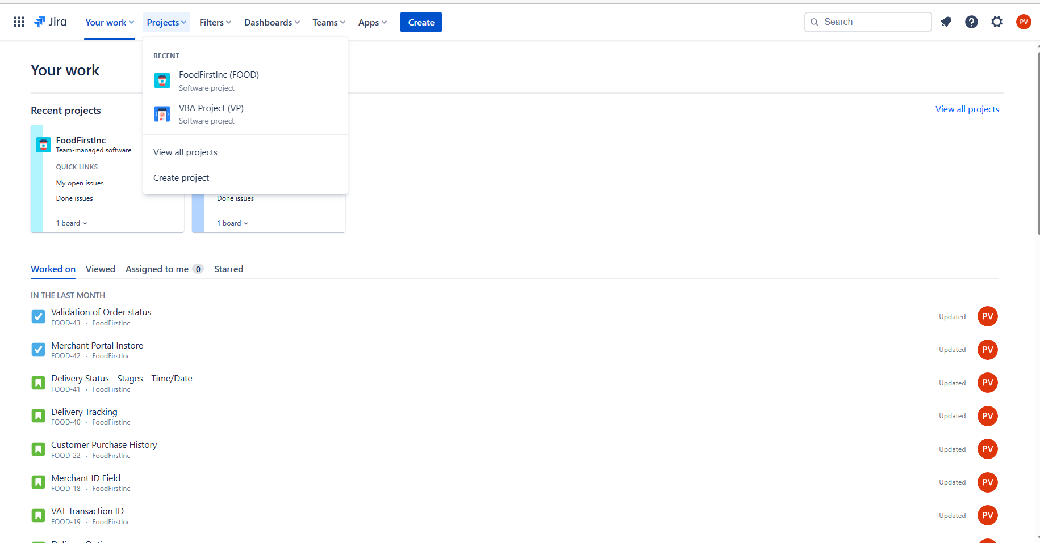
Creation of Project – Food First Inc
To create a project, click on projects, and click on create project.

Slide 4
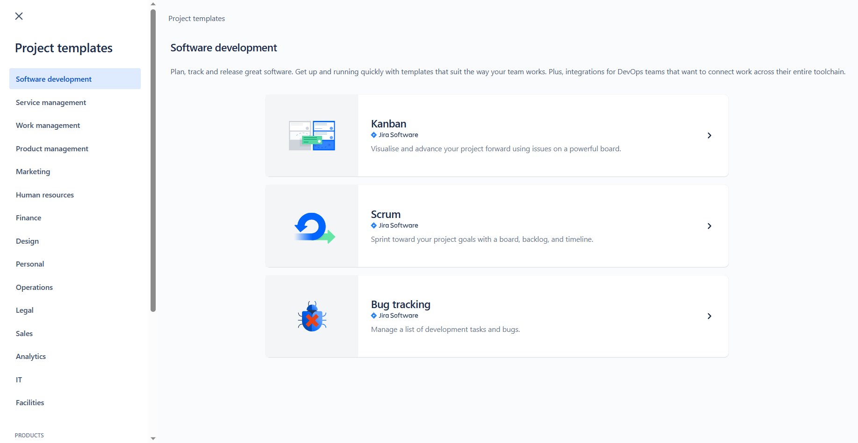
Creation of Project – Food First Inc
Click on Software development and then Scrum.

Slide 5
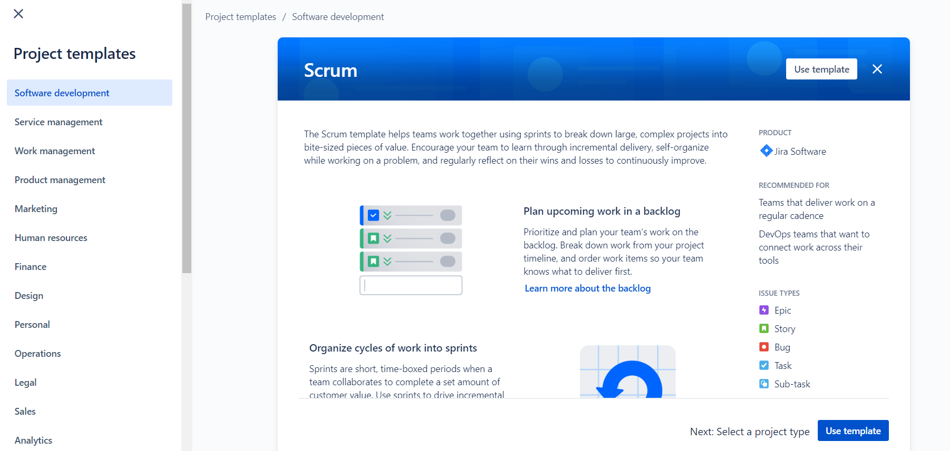
Creation of Project – Food First Inc
Click on Use Template.

Slide 6
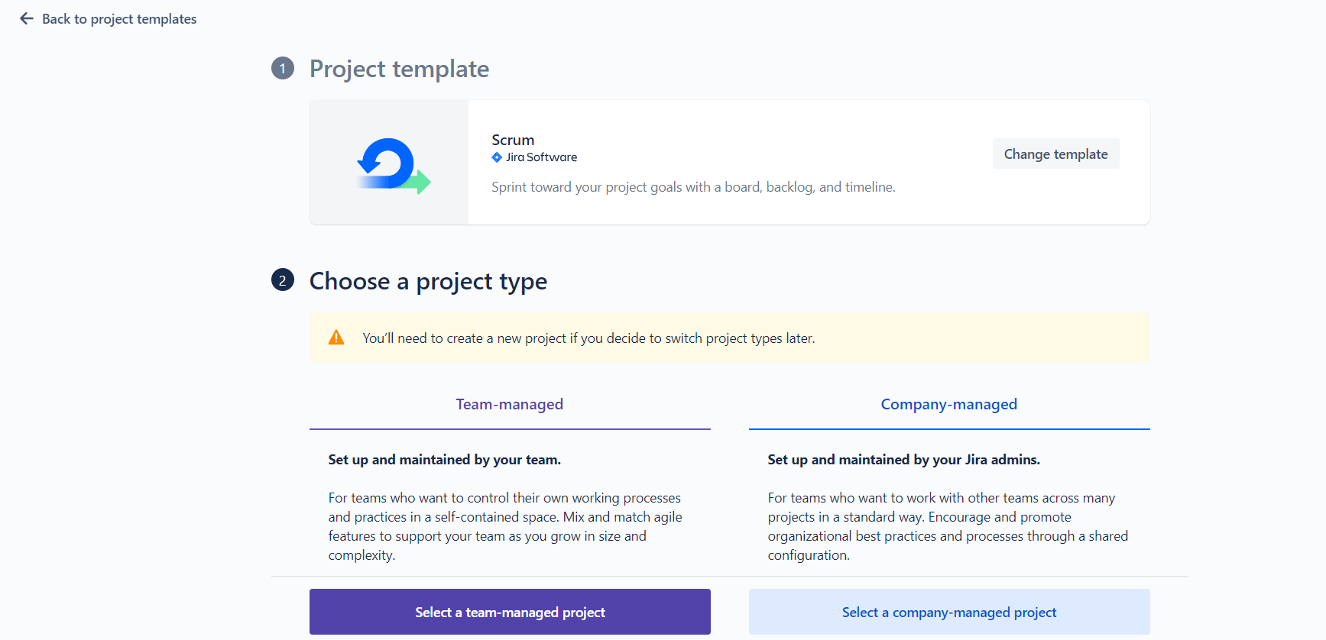
Creation of Project – Food First Inc
Click on Select a team-managed project.

Slide 7
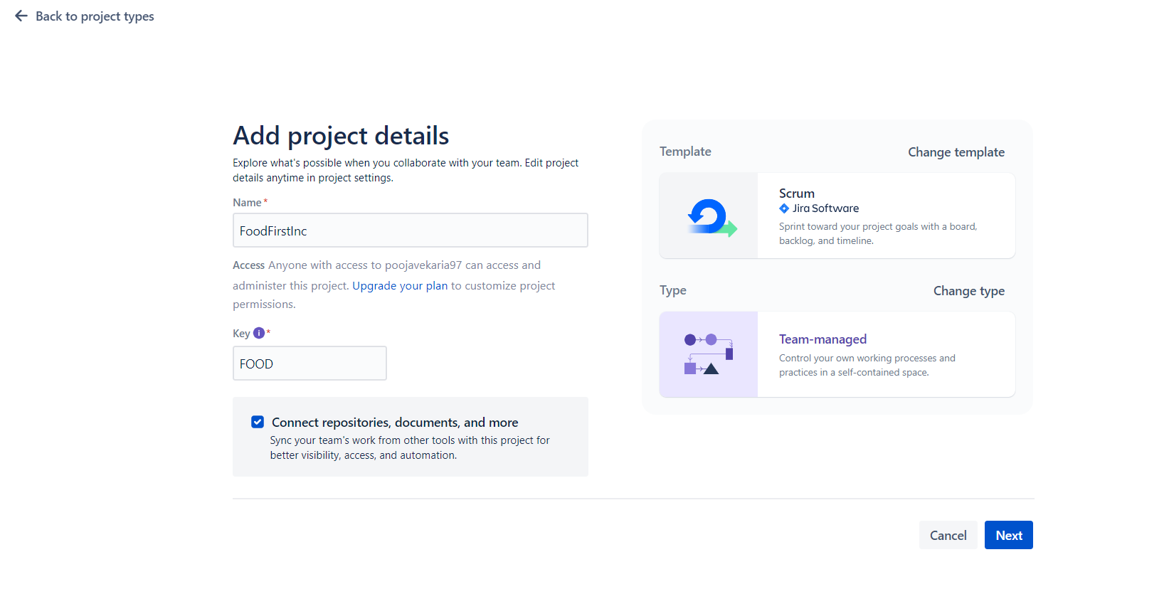
Creation of Project – Food First Inc
Complete Sections for Name (FoodFirstInc) and the Key(FOOD) is generated automatically but can be customised.

Slide 8
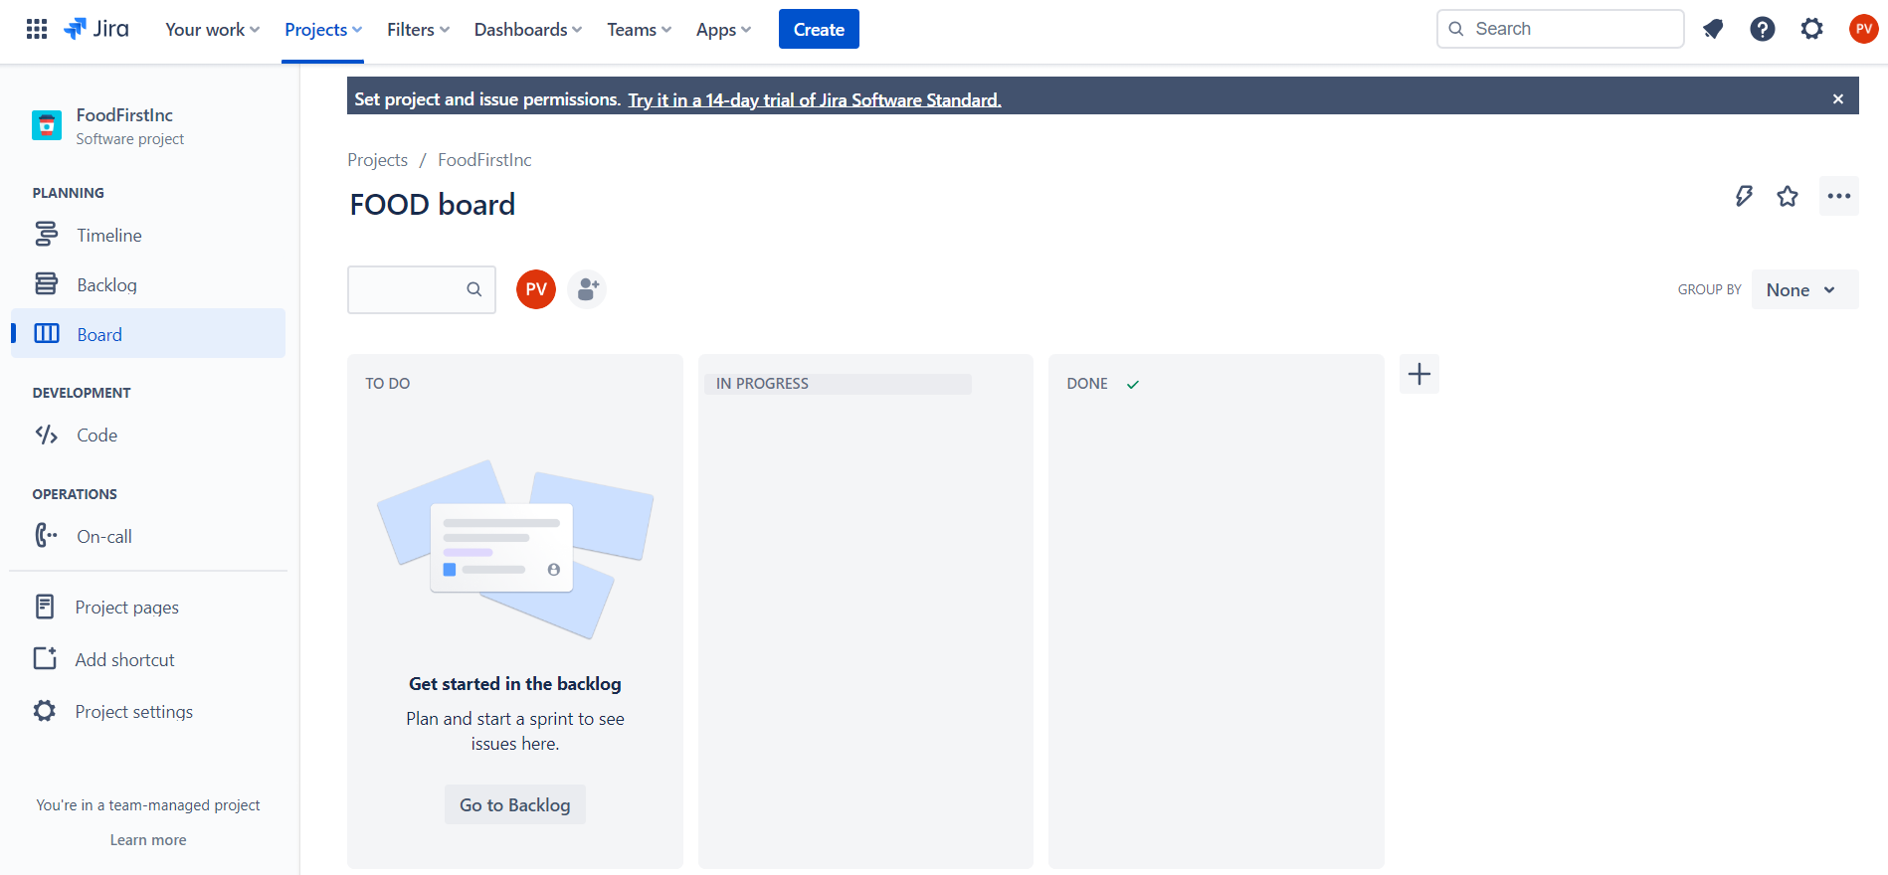
Project Created! – Food First Inc
The Jira project is now created and can be worked on.

Slide 9
Project Documentation

Slide 10
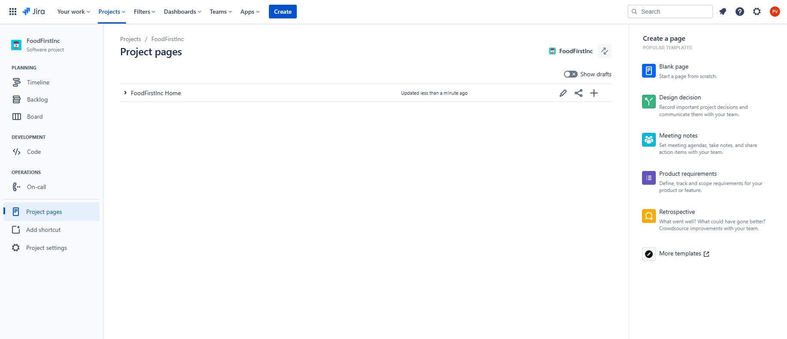
Creation of Project – Food First Inc
Click on FoodFirstInc Home.

Slide 11
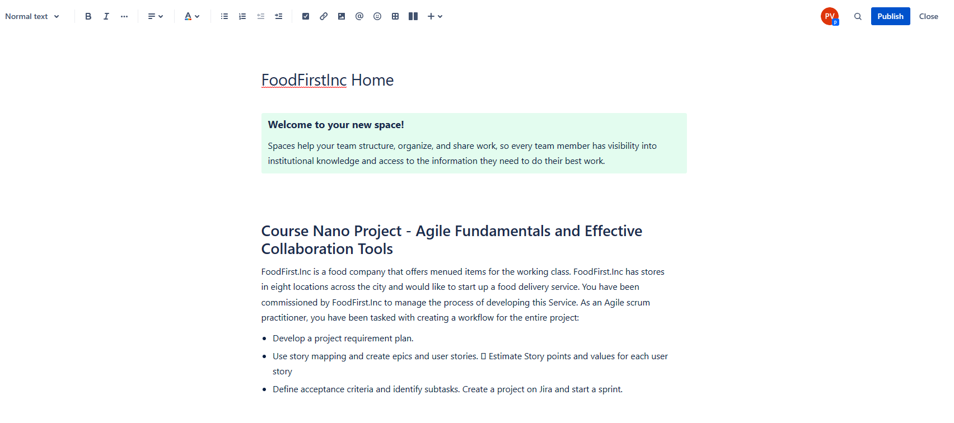
Creation of Project – Food First Inc
Add information regarding the project on the homepage and Publish.

Slide 12
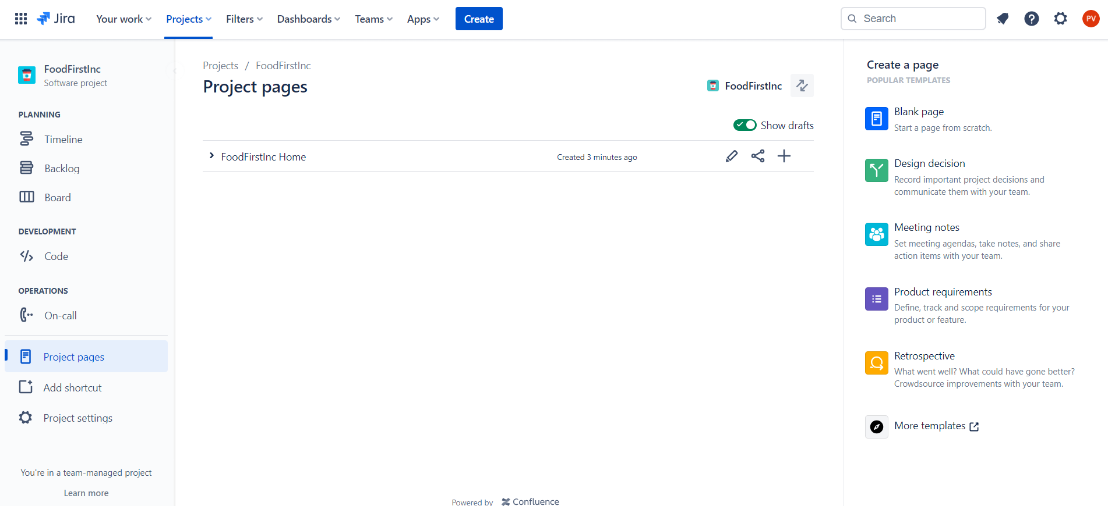
Create Confluence Doc – Food First Inc
In Project Pages, click the plus button and create a project requirement plan.

Slide 13
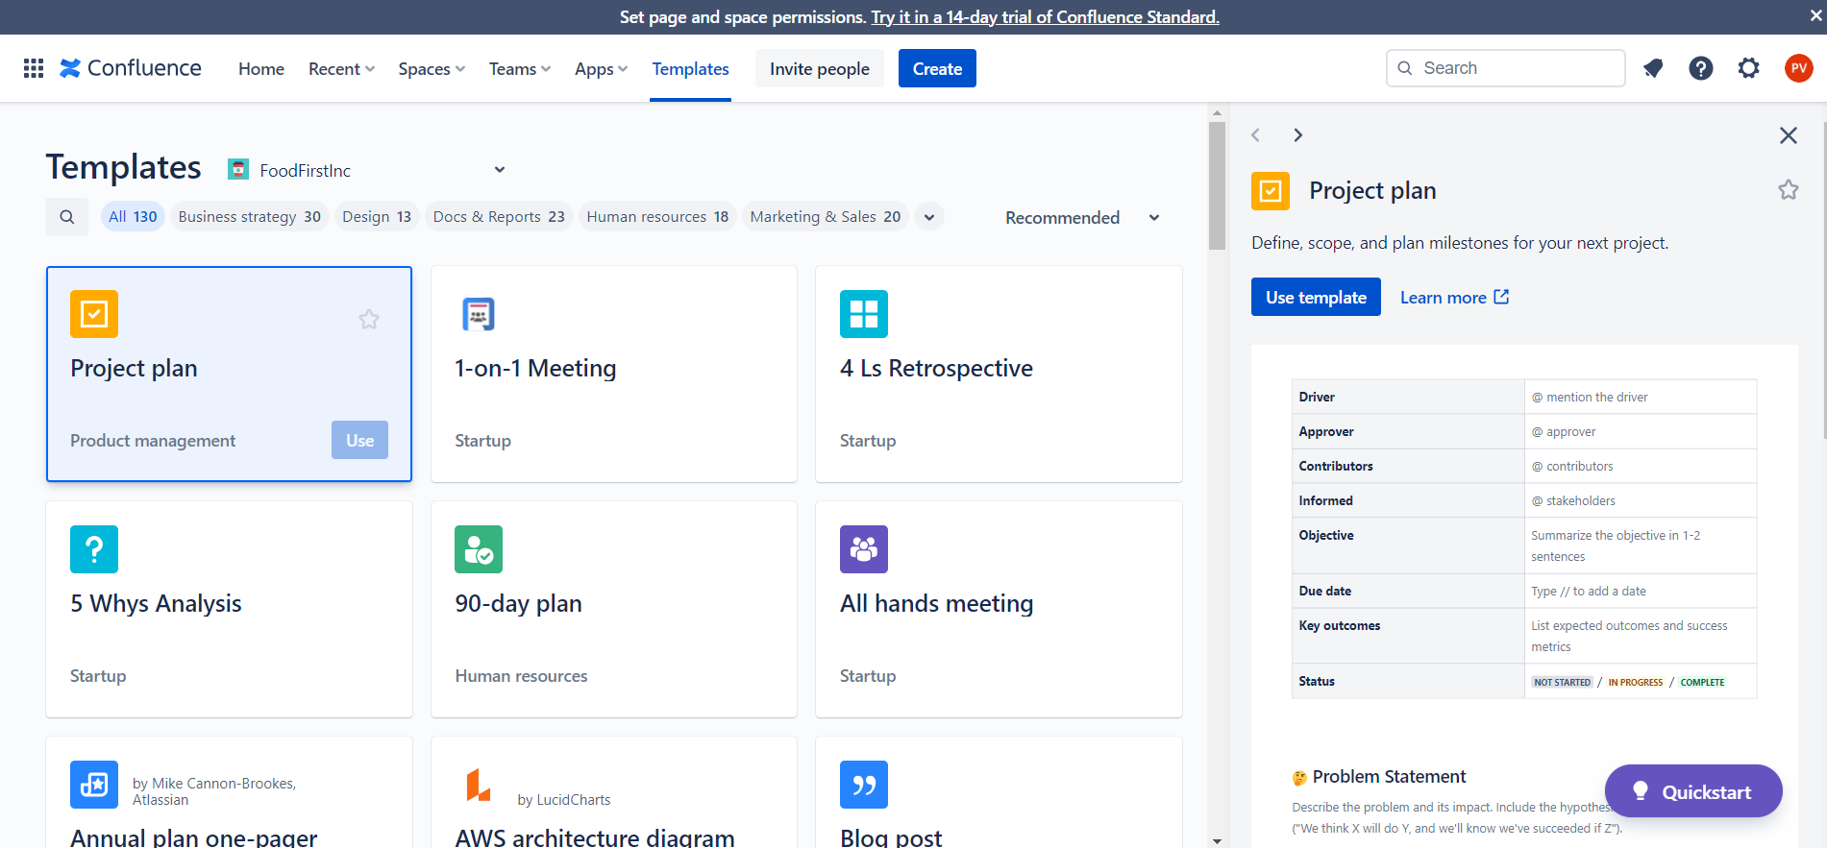
Create Project Plan – Food First Inc
Click on Project Plan and click use, on the side bar, click on use template.

Slide 14
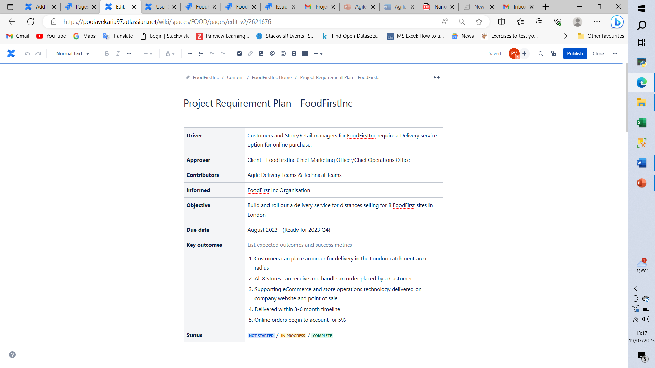
Project Planning – Food First Inc
Give the Project Requirement Plan a Title (FoodFirstInc) and complete the rest of the table.

Slide 15
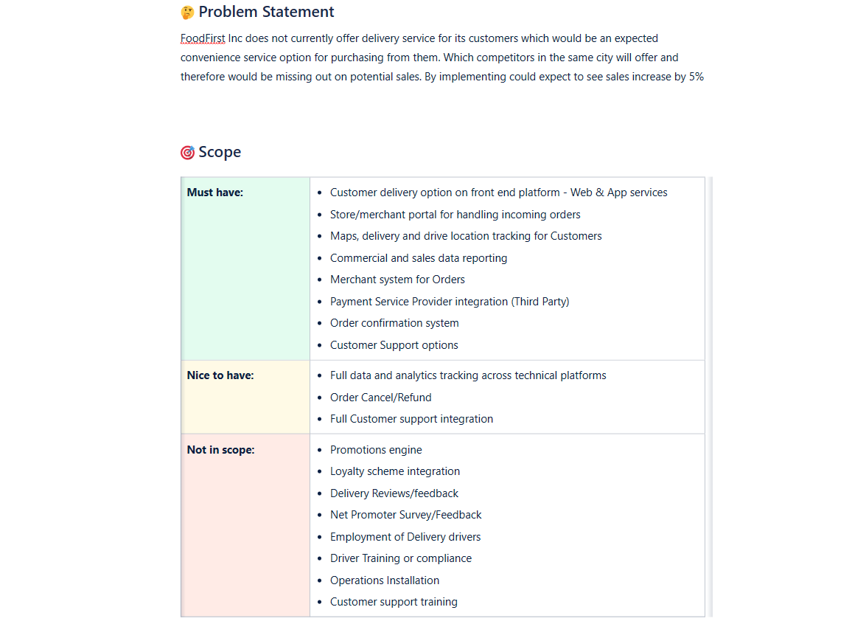
Project Planning – Food First Inc
Complete the Problem Statement and Scope.

Slide 16
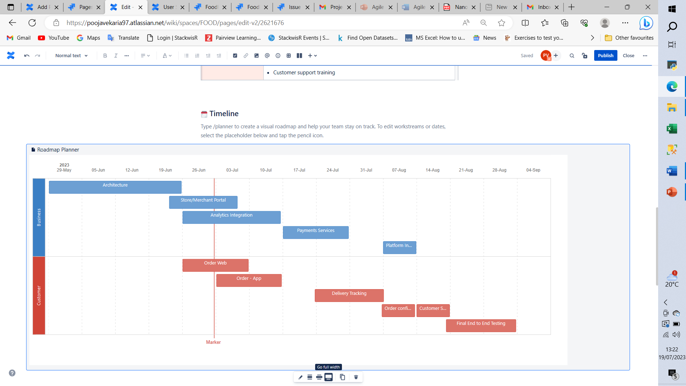
Project Planning – Food First Inc
Complete High-Level Timeline to keep track of the deliverables. Use Go full width to view Entire Timeline.

Slide 17
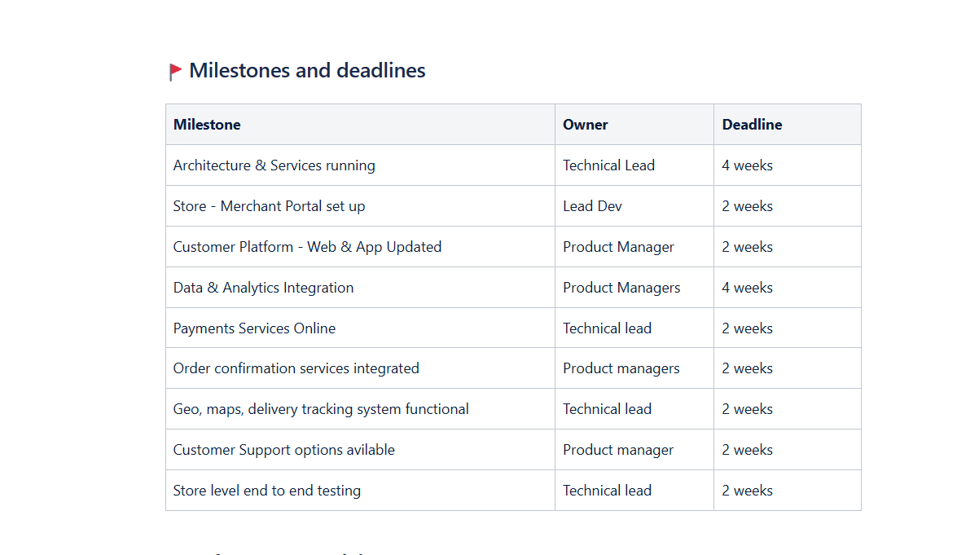
Project Planning – Food First Inc
Add in Milestones, Owners and Deadlines for the Project.

Slide 18
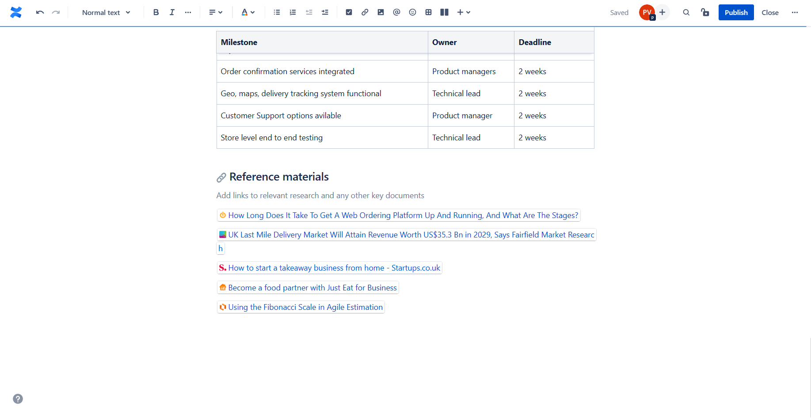
Project Planning – Food First Inc
Once the project plan is completed click on publish.

Slide 19
Confluence - User Story Mapping Exercise

Slide 20
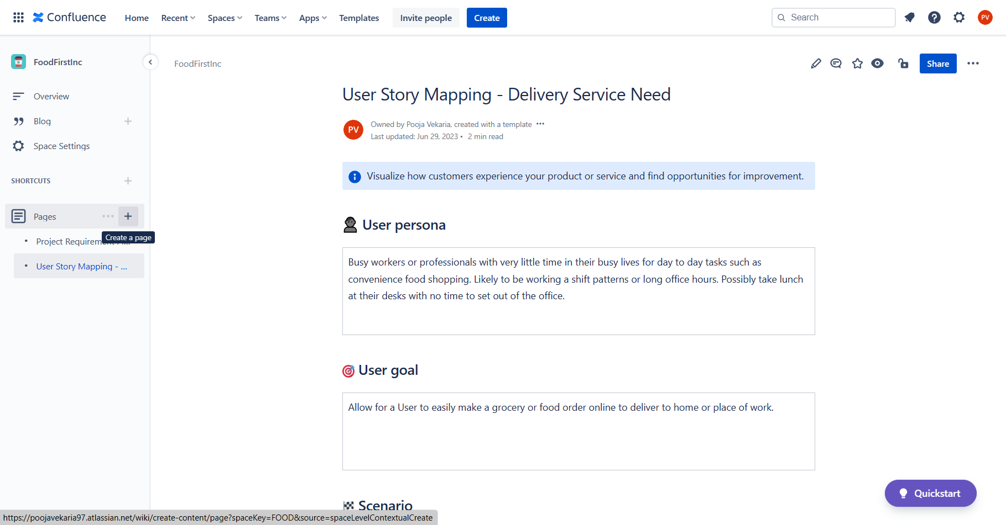
User Story Mapping– Food First Inc
Once the project requirement plan is completed add a new page for user story mapping.

Slide 21
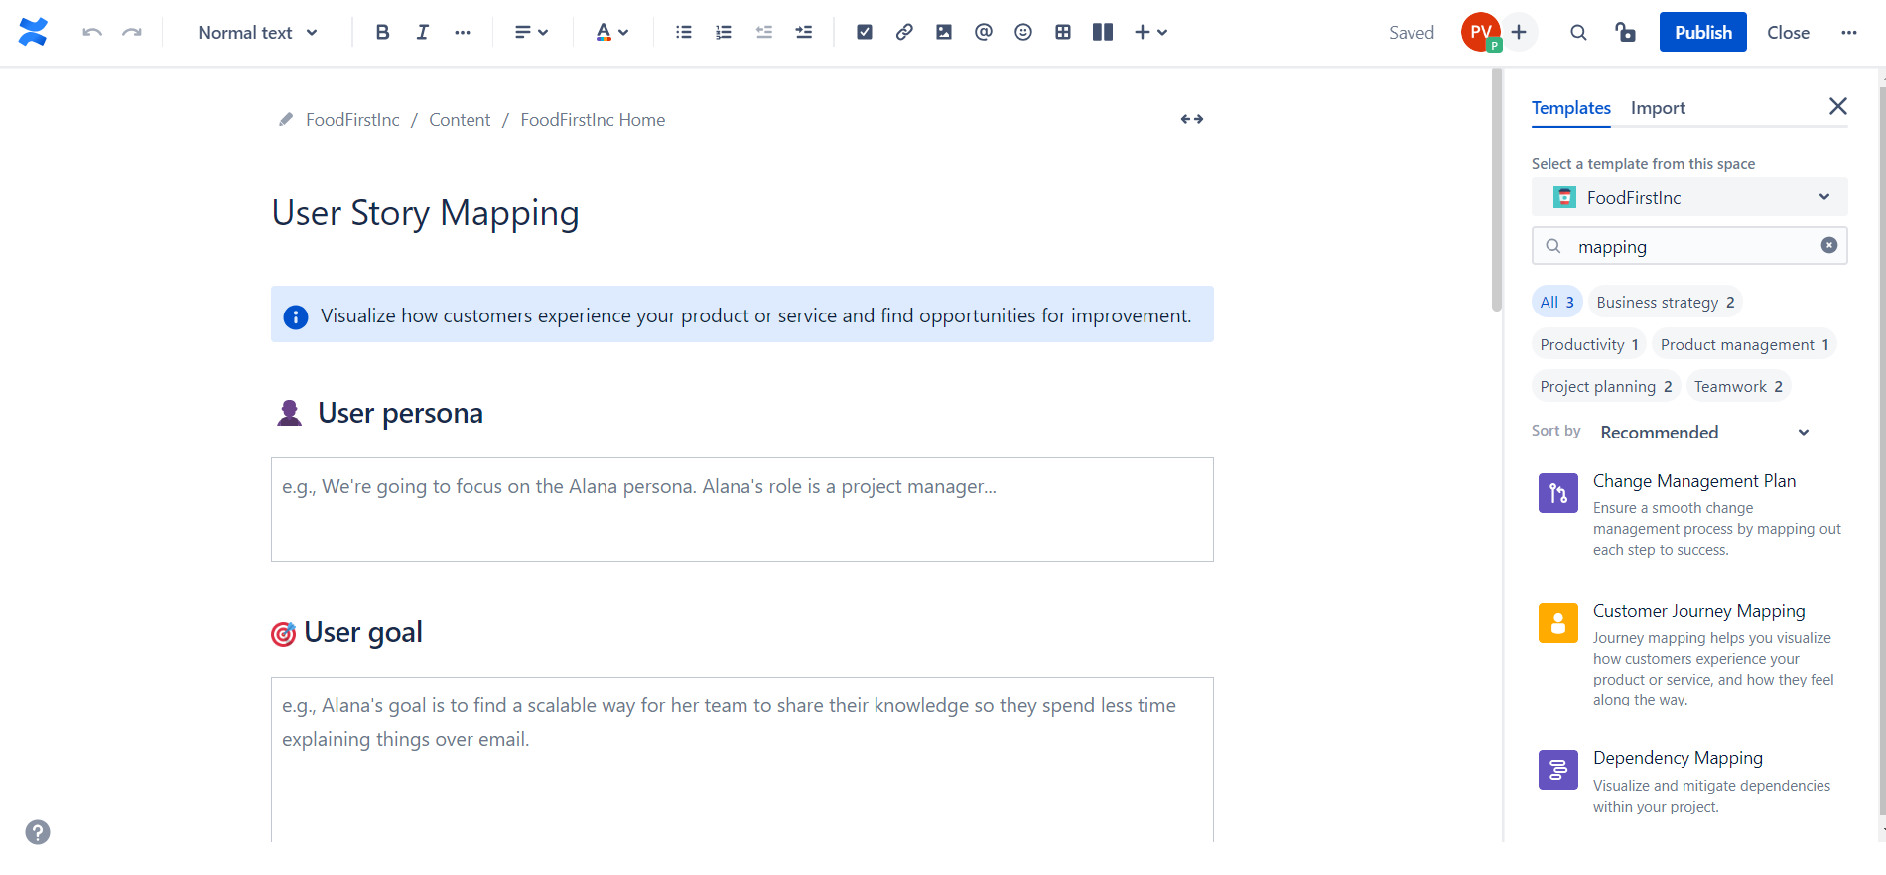
Project Planning – Food First Inc
On the sidebar select Customer Journey Mapping, To populate template for user story mapping.

Slide 22
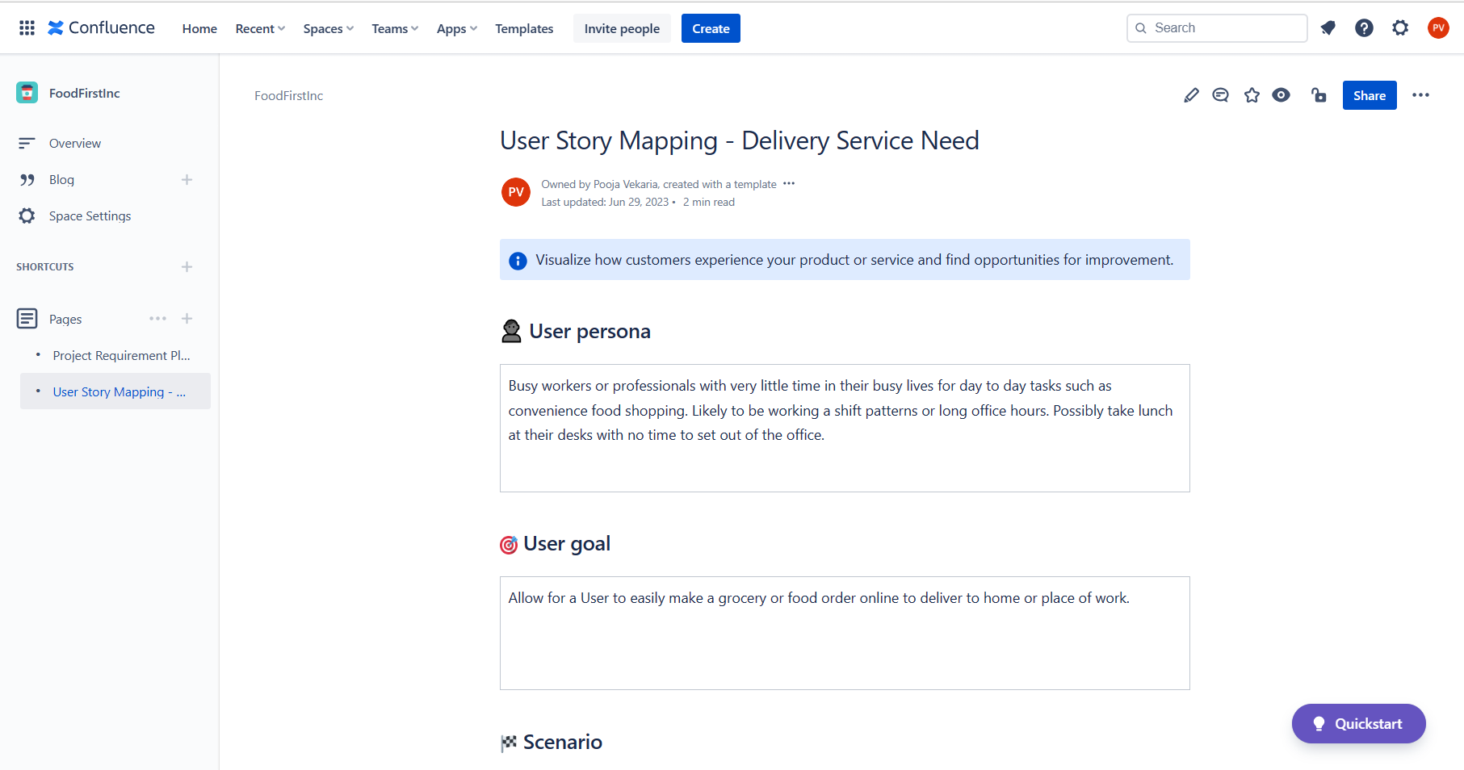
User Story Mapping– Food First Inc
Complete User Persona and User Goal.

Slide 23
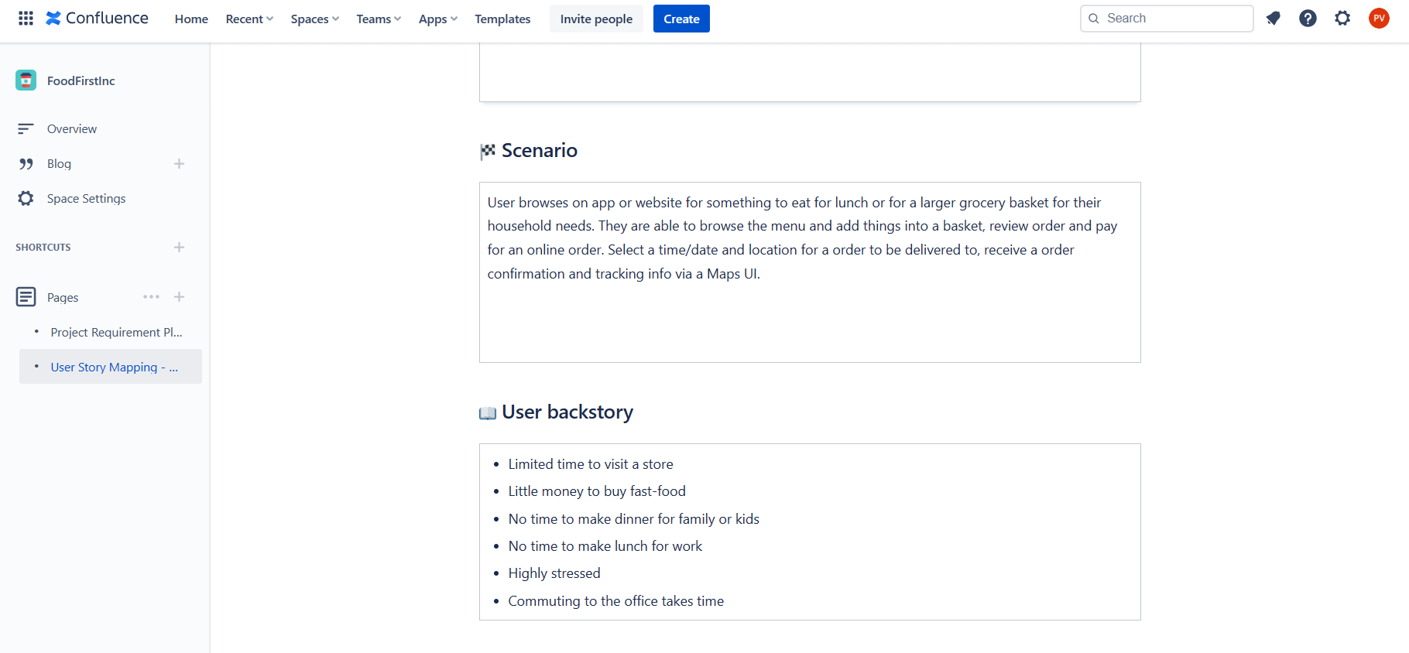
User Story Mapping– Food First Inc
Complete Scenario and User backstory.

Slide 24
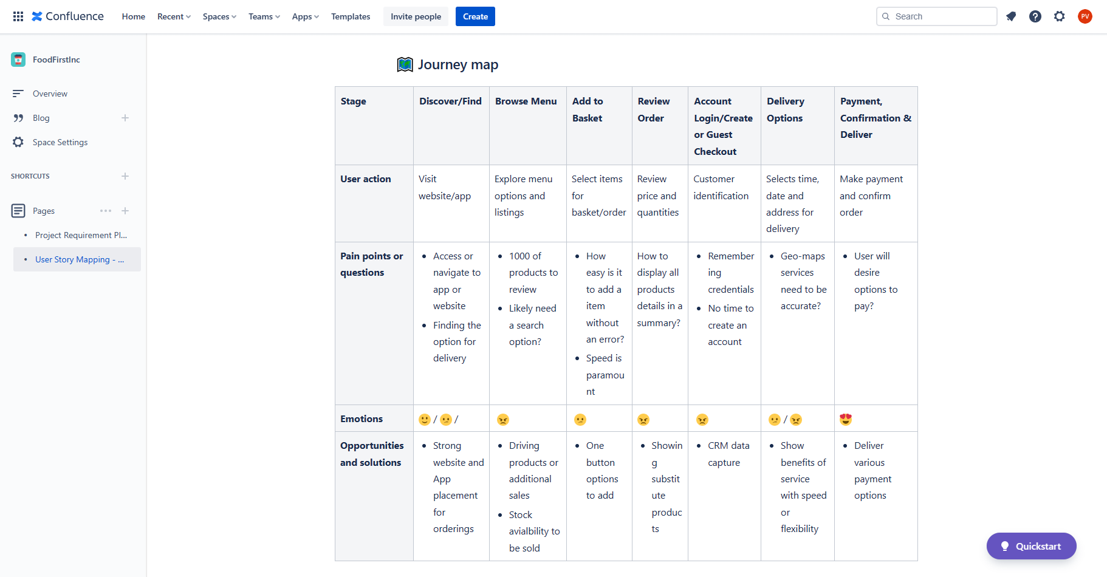
User Story Mapping– Food First Inc
Complete Journey Map and publish user story mapping page.

Slide 25
Jira – Epics Creation

Slide 26
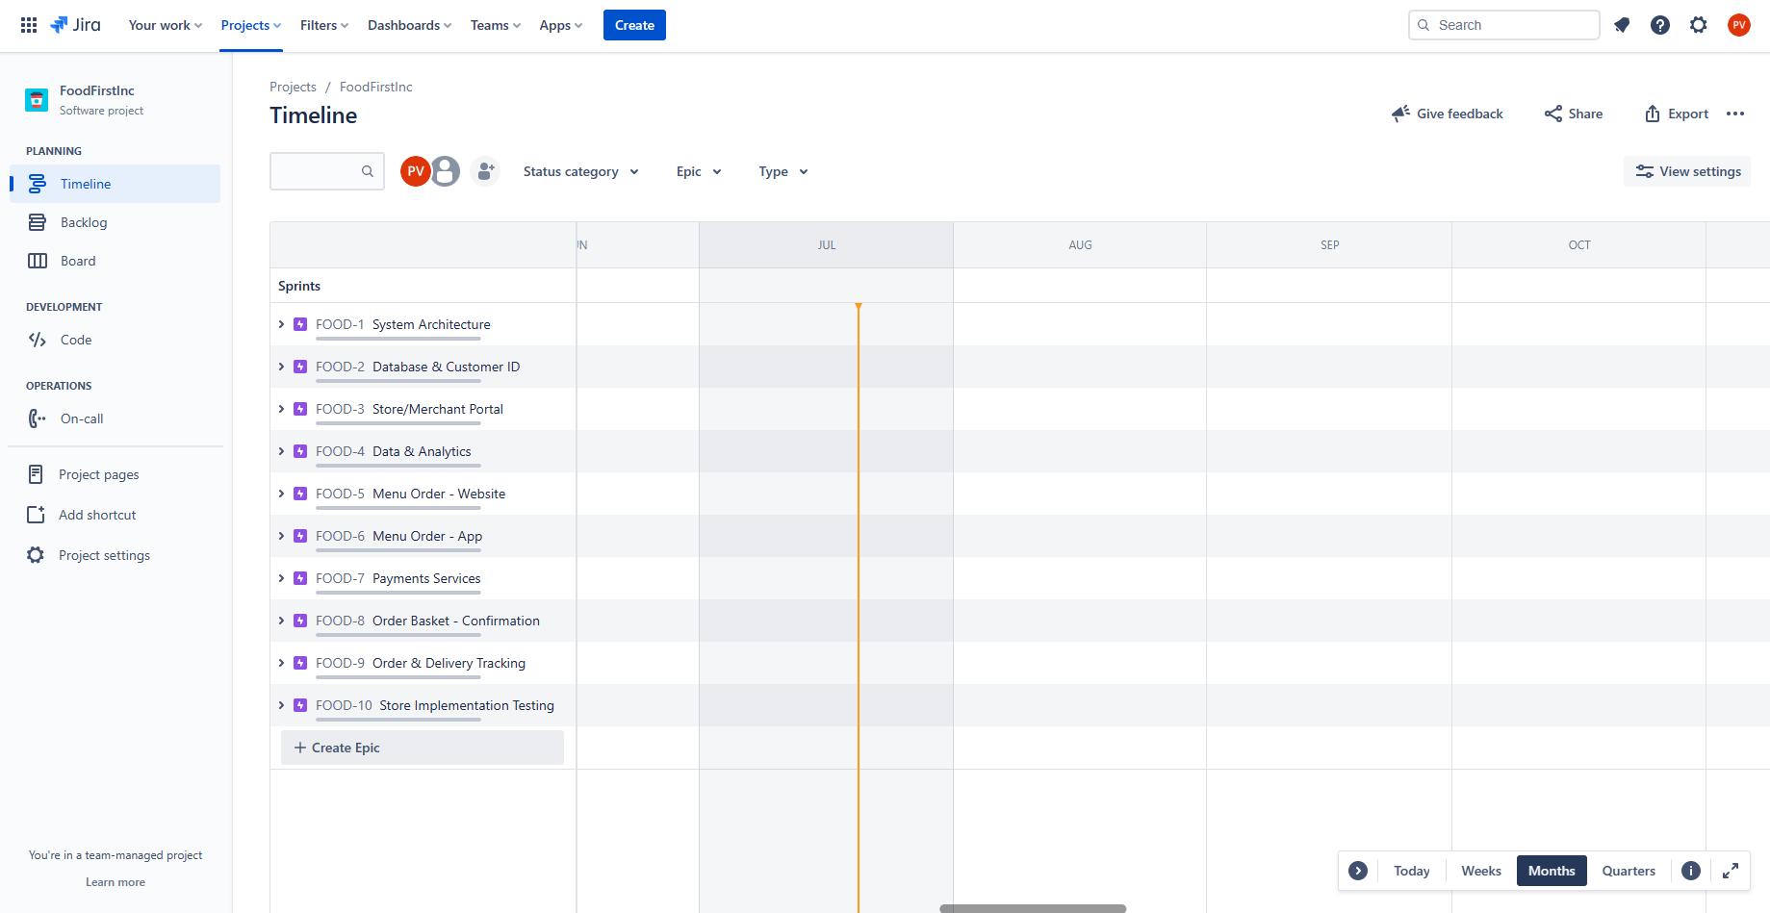
Creating Epics– Food First Inc
Click on the timeline and the create epic to start creation for epics the epics are taken from the project requirement plan in the milestones section.

Slide 27
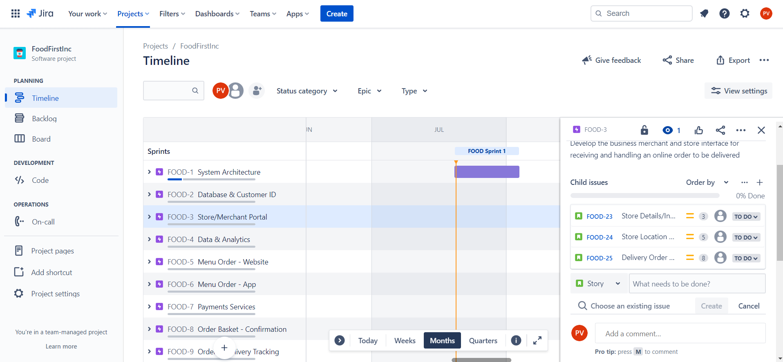
Creating Issues– Food First Inc
Select EPIC
Select Task or Story
Quick add Tasks or Stories based on the project requirements and outcomes from the User Story Mapping exercise
With a Ticket Title and name

Slide 28
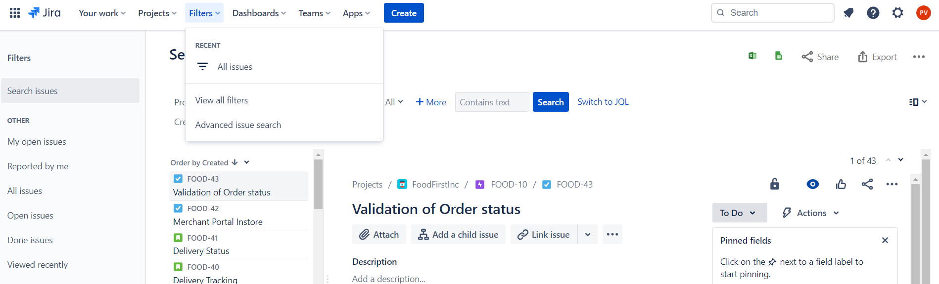
Creating Issues– Food First Inc
Select Filters
Then under the “Advance issue search” can view or find specific issues/tickets

Slide 29
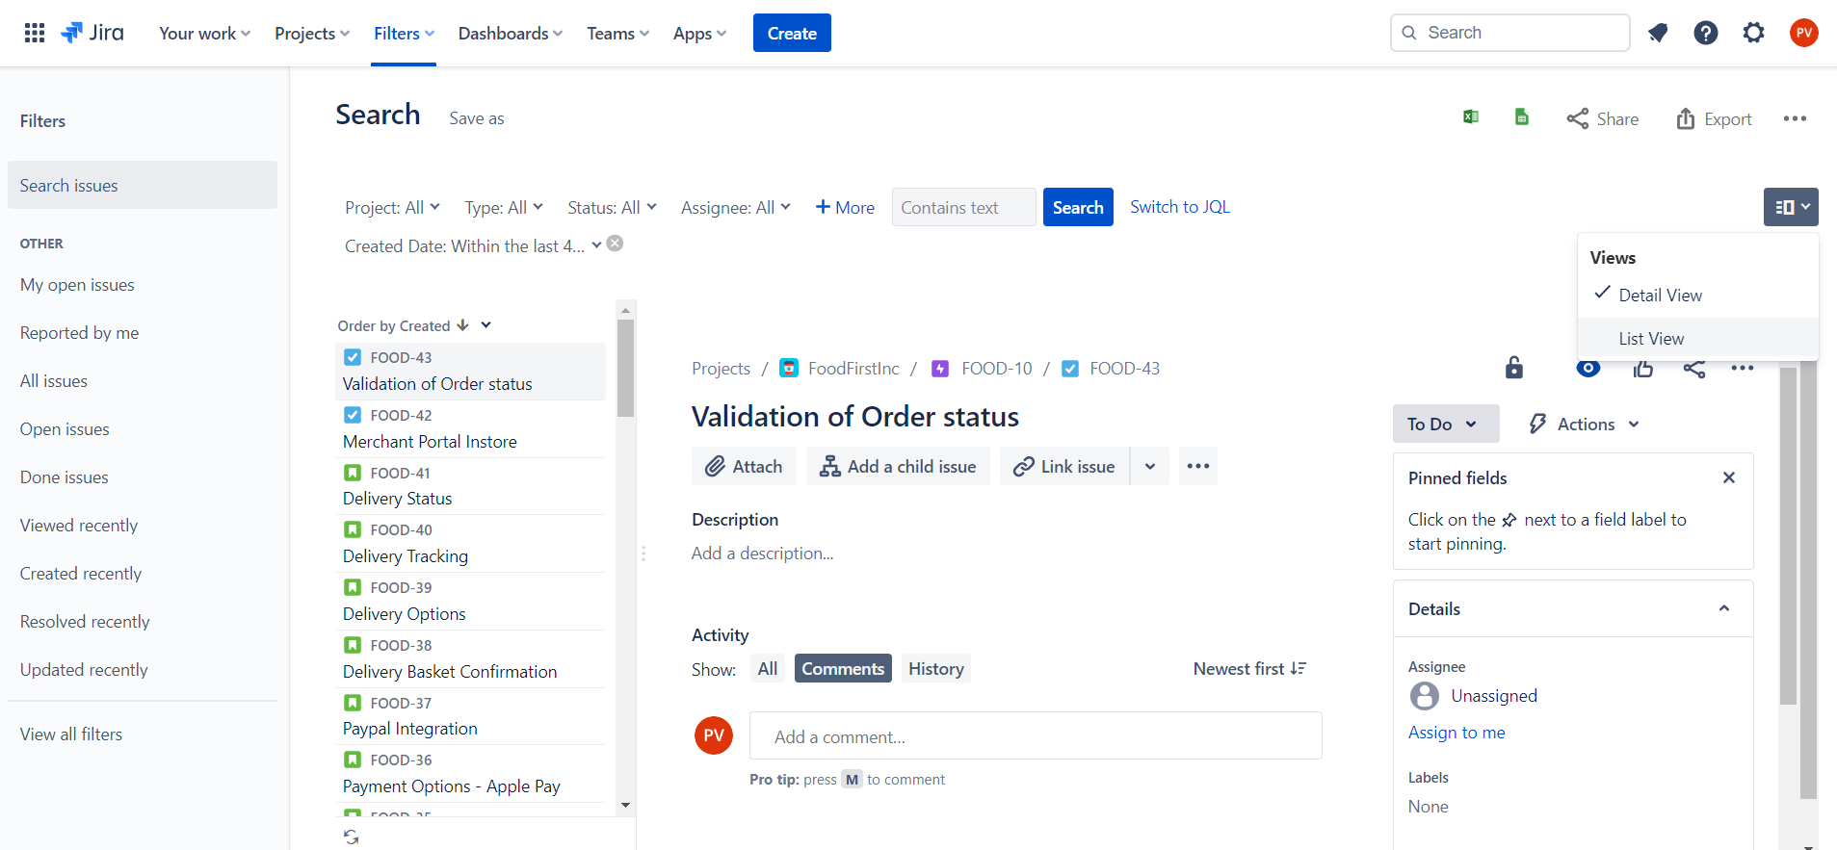
Creating Issues– Food First Inc
Select Detail or List View
Easy options to begin writing up tickets

Slide 30
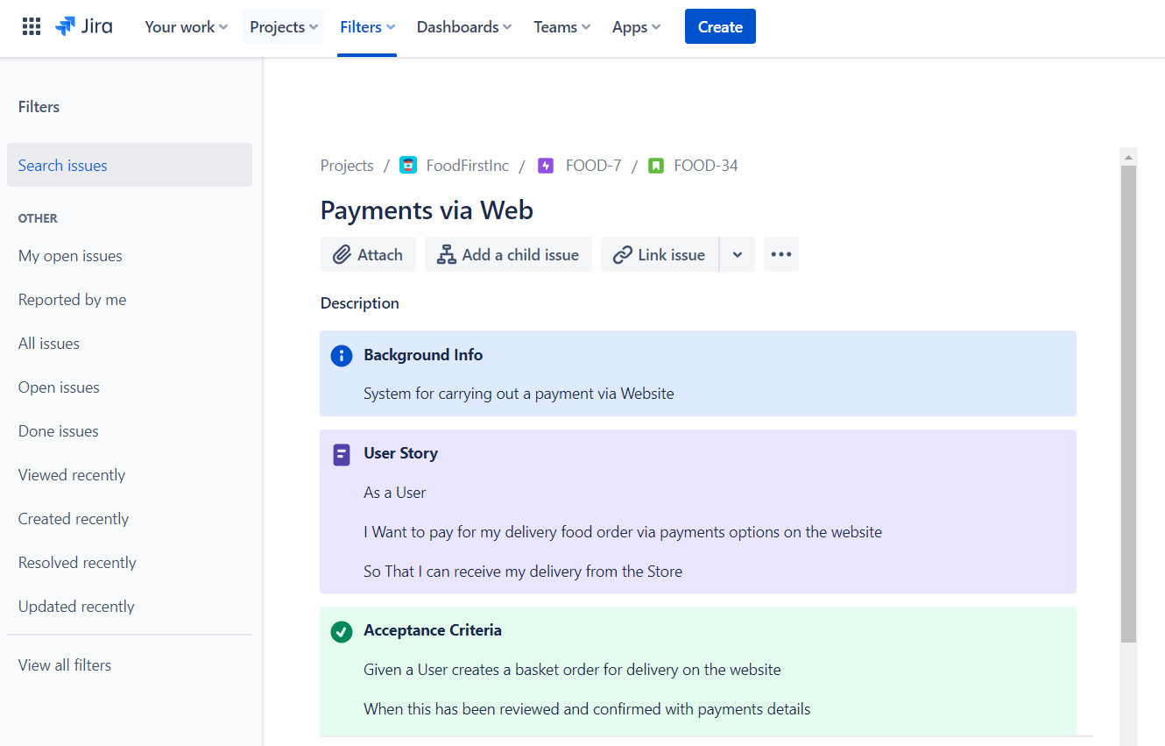
Creating Issues– Food First Inc
In the List View can select to open a ticket
Then add a User Story and Acceptance Criteria to each Story ticket

Slide 31
Estimation

Slide 32
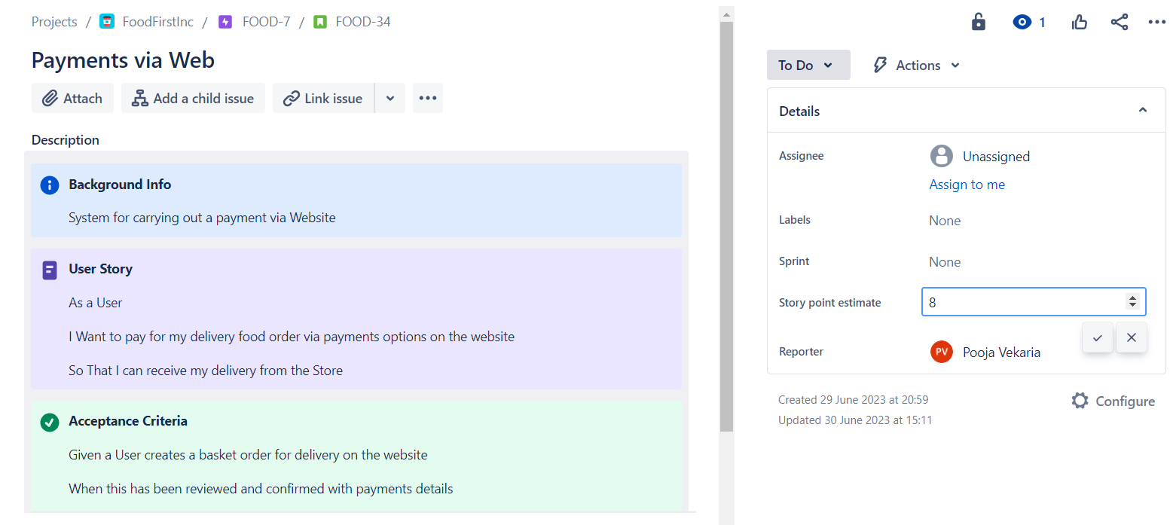
Creating Issues– Food First Inc
Estimate story points using the guideline below
https://www.lucidchart.com/blog/fibonacci-scale-for-agile-estimation
Enter a value based on the theory for Story points in the JIRA ticket view
Select Tick to complete field

Slide 33
Spring Planning

Slide 34
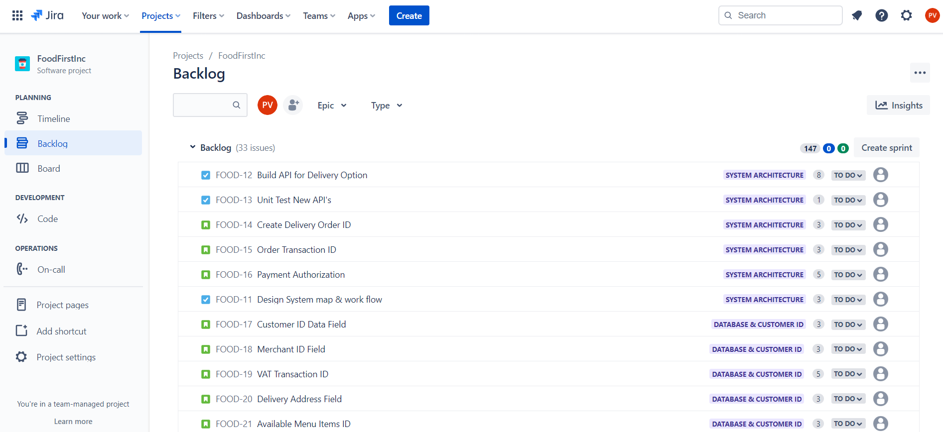
Sprint Planning– Food First Inc
Go to Backlog tab
Select Create Sprint

Slide 35
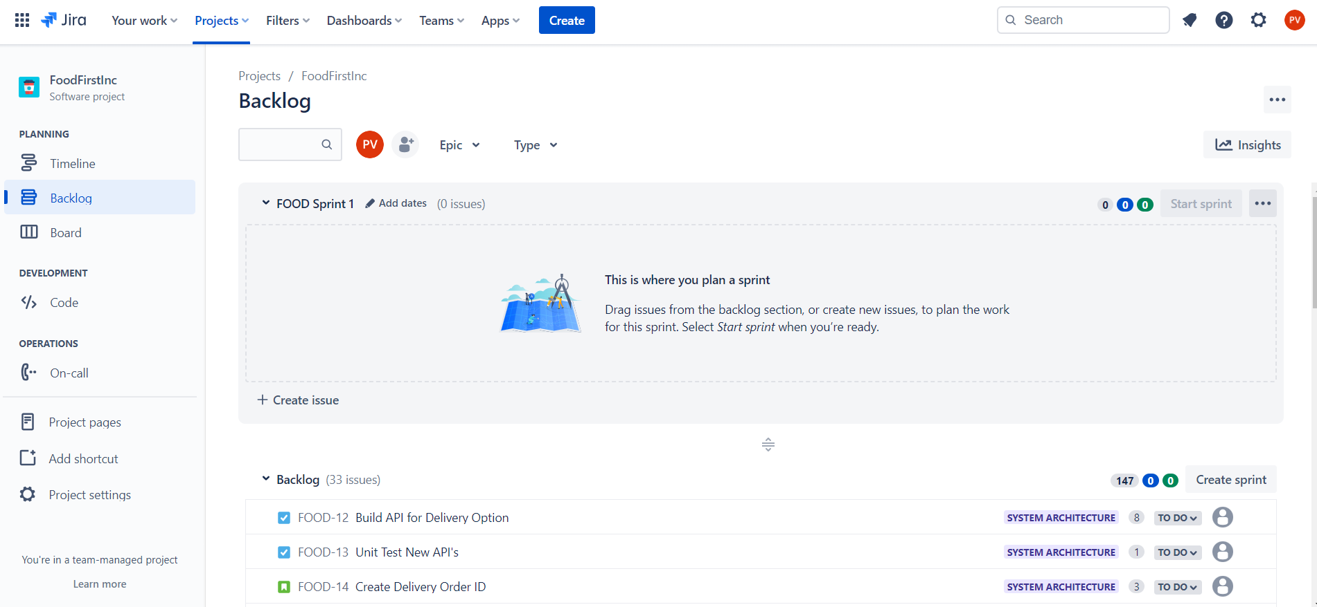
Sprint Planning– Food First Inc
Sprint would have then been created in the Backlog
Sprint 1
Ready for items to be added from the backlog list

Slide 36
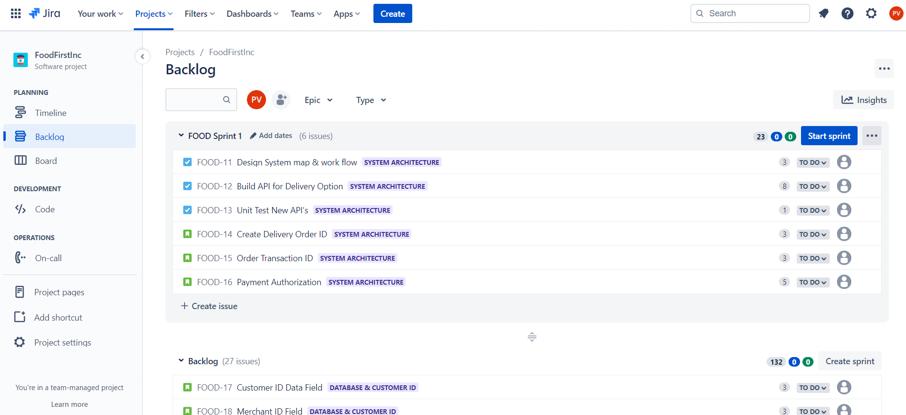
Sprint Planning– Food First Inc
Drag items from the backlog
Agree your story points with scrum team
To Start Sprint, click start sprint.

Slide 37
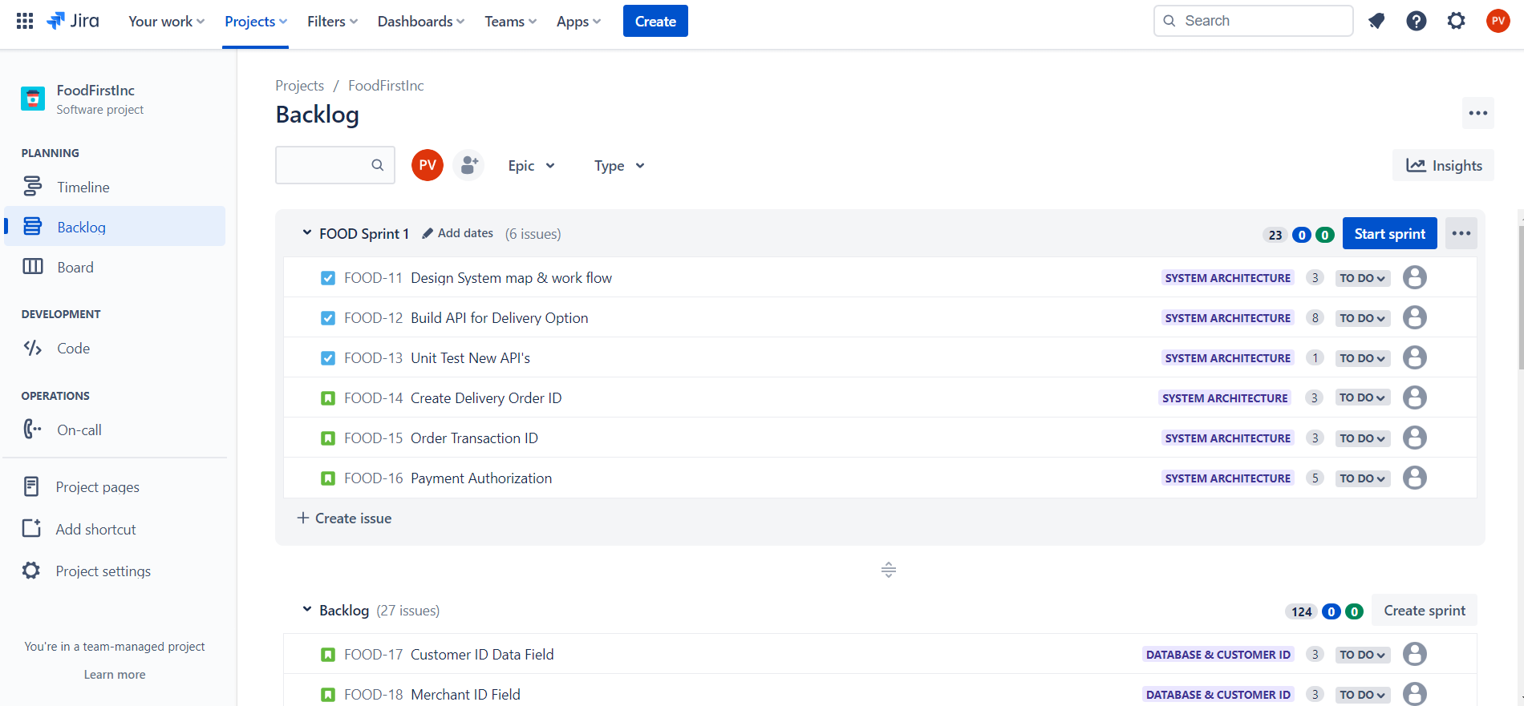
Sprint Planning– Food First Inc
Select Start Sprint

Slide 38
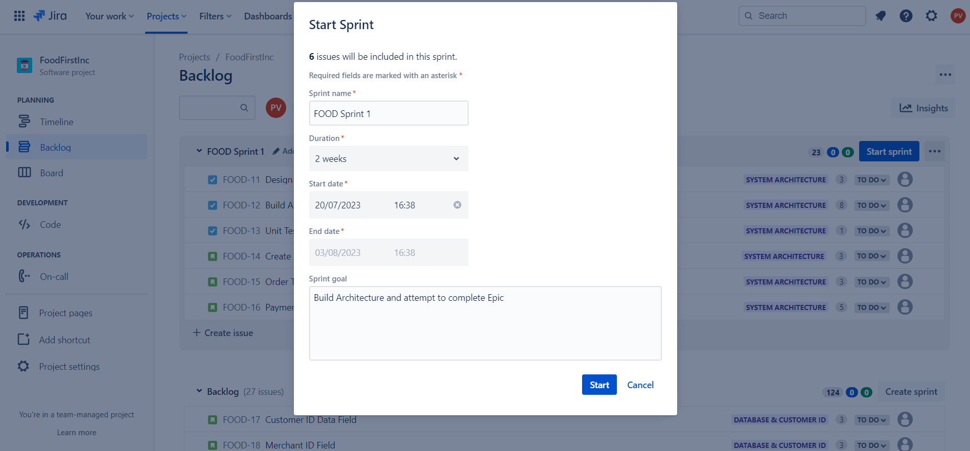
Sprint Planning– Food First Inc
Add Sprint Goal
Start Sprints for next two weeks

Slide 39
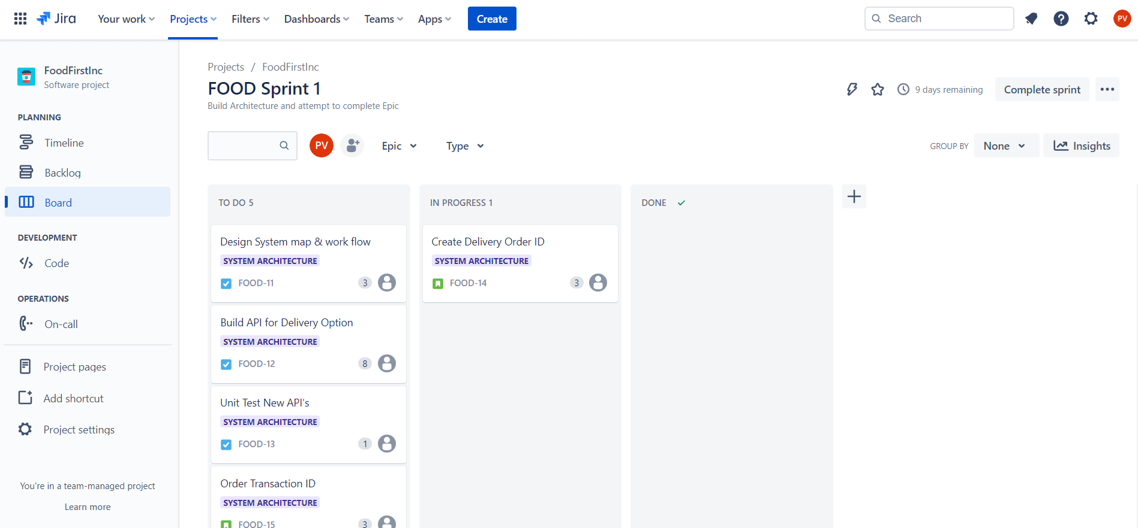
Sprint Planning– Food First Inc
Sprint has started
Board has been updated with stories
Team can move Items into “Progress”

Slide 40
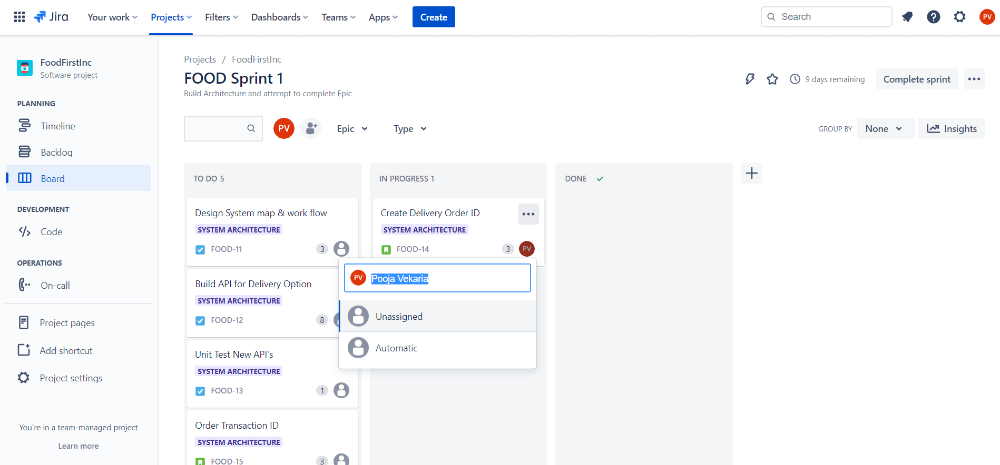
Sprint Planning– Food First Inc
Stories can be dragged across the board and edited
Assigned or assignee changed during the sprint on the board

Slide 41
Artefacts Links
Epic View: https://poojavekaria97.atlassian.net/jira/software/projects/FOOD/boards/2/timeline
Backlog view: https://poojavekaria97.atlassian.net/jira/software/projects/FOOD/boards/2/backlog
Board View: https://poojavekaria97.atlassian.net/jira/software/projects/FOOD/boards/2
All Tickets View: https://poojavekaria97.atlassian.net/issues/?jql=order%20by%20created%20DESC
Project Requirement document: https://poojavekaria97.atlassian.net/wiki/spaces/FOOD/pages/2621676/Project+Requirement+Plan+-+FoodFirstInc
User Story Mapping document: https://poojavekaria97.atlassian.net/wiki/spaces/FOOD/pages/2621764/User+Story+Mapping+-+Delivery+Service+Need

